Slide 1

Urban Mobility Insights: Predictive Analysis of NYC Taxi Demand
Presented By:
Vasanth Manne
Lahari Vootla

Slide 2
Dataset Information:
Dataset name: yellow_tripdata_2016-03.csv
Dataset link: https://www.kaggle.com/datasets/elemento/nyc-yellow-taxi-trip-
data/data?select=yellow_tripdata_2016-03.csv
About Dataset:
The dataset comprises 12,210,952 entries with 19 columns, representing Yellow Taxis Data for the months of Jan 2015 and Jan-Mar 2016 in New York City. Extracted from CSV files on the NYC TLC website, the data includes trip details such as VendorID, pickup and dropoff date and time, passenger count, trip distance, geographic coordinates, payment details, and fare information. Notably, the dataset predates a transition by the TLC to indexing regions instead of providing specific coordinates. It serves as a valuable resource for practicing clustering and time-series analysis. The columns feature a mix of integer, floating-point, and object data types, contributing to a comprehensive dataset suitable for diverse analyses, with a memory usage of 1.7+ GB.

Slide 3
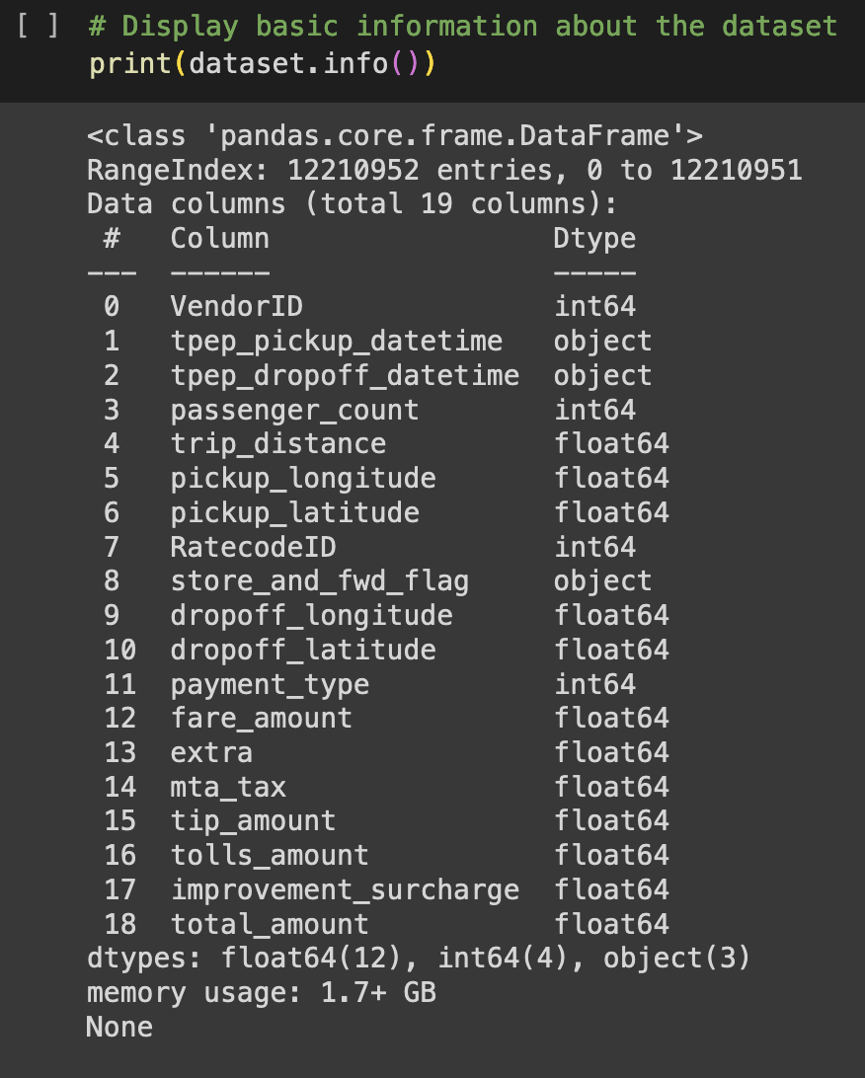

Slide 4
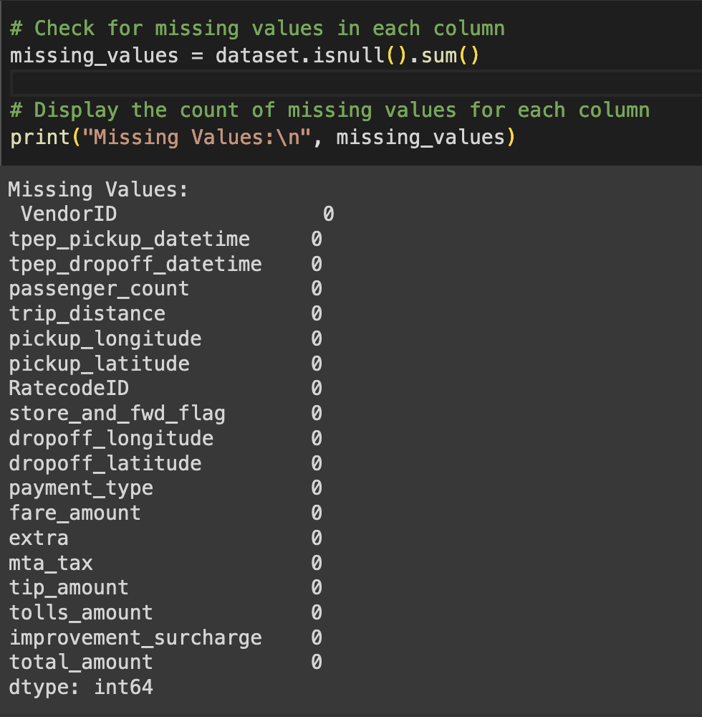
Data Preprocessing
Data Quality Check - Missing Values Analysis
In this code snippet, a check for missing values in each column of the dataset is performed using the isnull() function. The resulting count of missing values for each column is then displayed using the sum() function. This analysis helps identify and quantify any gaps or null entries in the dataset, providing crucial insights into potential data quality issues that may require attention.

Slide 5
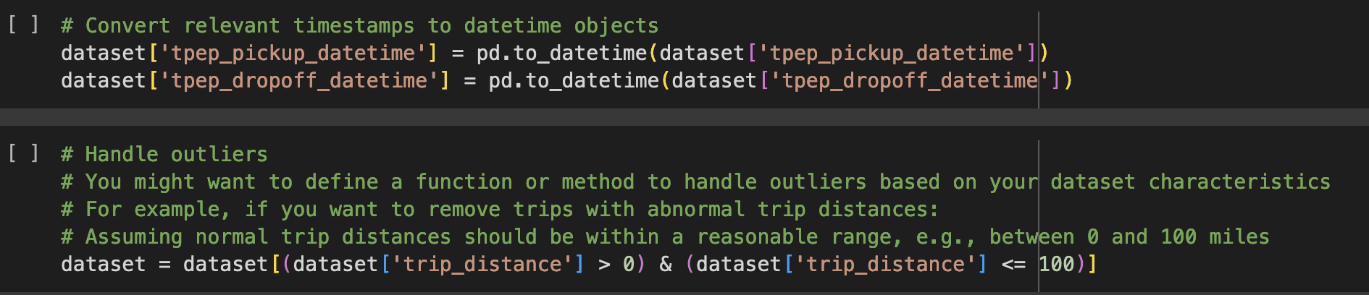
Timestamp Conversion and Outlier Handling
The code converts timestamp columns ('tpep_pickup_datetime' and 'tpep_dropoff_datetime') in the dataset to datetime objects, facilitating proper time-related analysis. Additionally, it suggests handling outliers in the 'trip_distance' column by filtering the dataset to include only trips with distances between 0 and 100 miles, offering a hypothetical approach to manage abnormal distance values. Users can customize outlier handling based on their dataset characteristics and specific requirements.

Slide 6
Feature Engineering (Spatial and Temporal Features):
Spatial Features: The code defines spatial features based on predefined zones. In this case, it categorizes pickups and dropoffs into 'Manhattan' or 'Other' regions. You can customize or define your own regions based on the characteristics of your dataset.
Temporal Features: Extracts temporal features such as the hour of the day, day of the week, and month from the pickup timestamps. Creates additional features like 'is_weekend' to capture the weekend/weekday patterns.
These spatial and temporal features provide valuable information that can be used for further analysis and modeling in predicting taxi demand. Adjust the code based on the specifics of your dataset and the features you find most relevant.

Slide 7
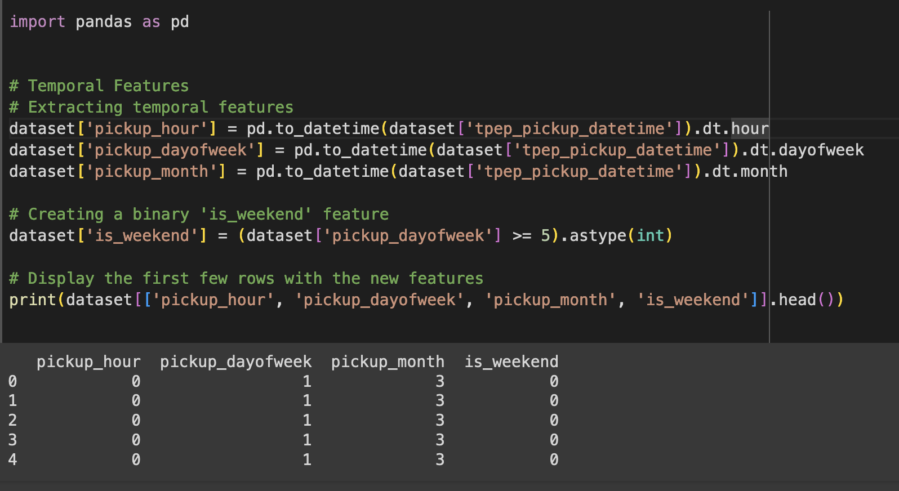
This code enriches a pandas DataFrame named 'dataset' with temporal features derived from the 'tpep_pickup_datetime' column. It creates new columns for the pickup hour, day of the week, and month. Additionally, a binary 'is_weekend' feature is introduced to indicate whether a trip occurred on a weekend. The resulting DataFrame is then printed to showcase the dataset with these new temporal features, enhancing its suitability for time-based analyses.

Slide 8
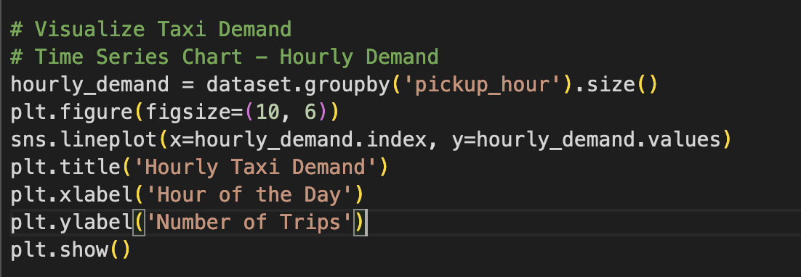
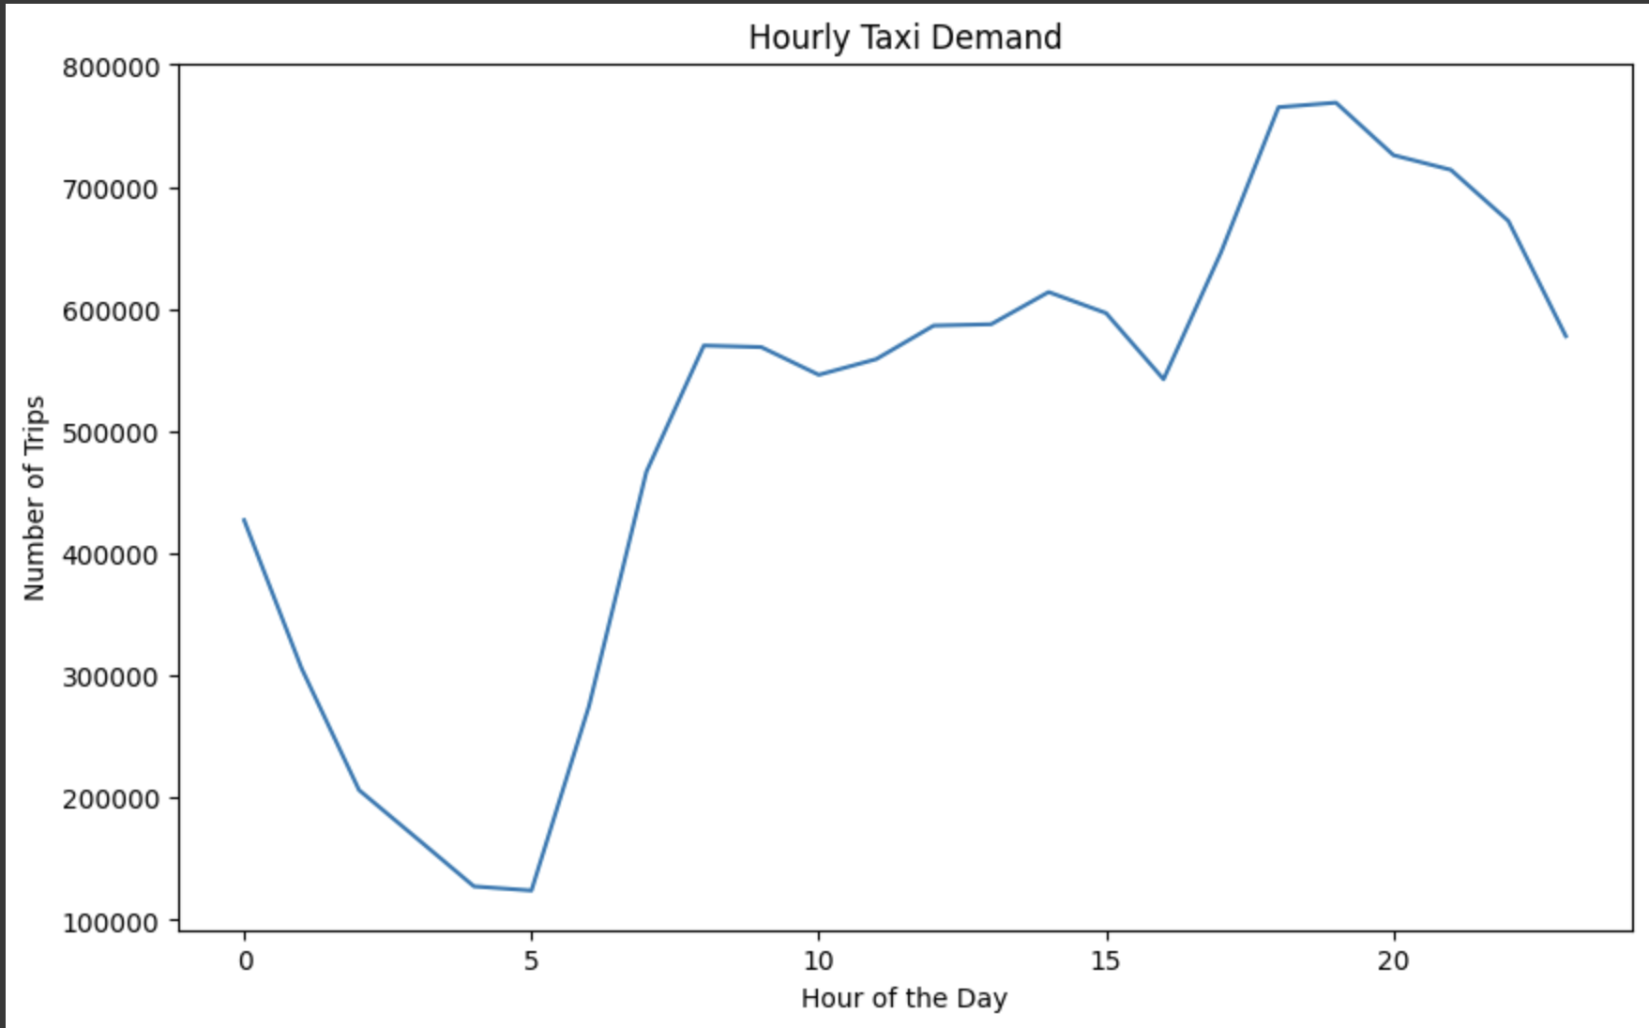
This code visualizes the hourly demand for taxi services using a time series chart. The 'pickup_hour' column is aggregated to calculate the number of trips for each hour, and the resulting data is plotted with Seaborn. The chart provides a clear depiction of the fluctuating demand throughout the day, offering insights into peak and off-peak hours for taxi services.

Slide 9
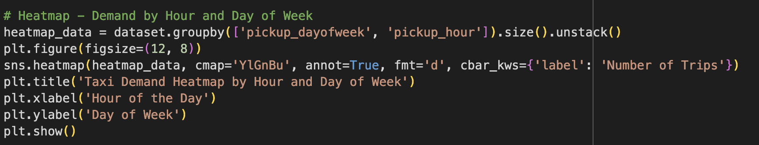
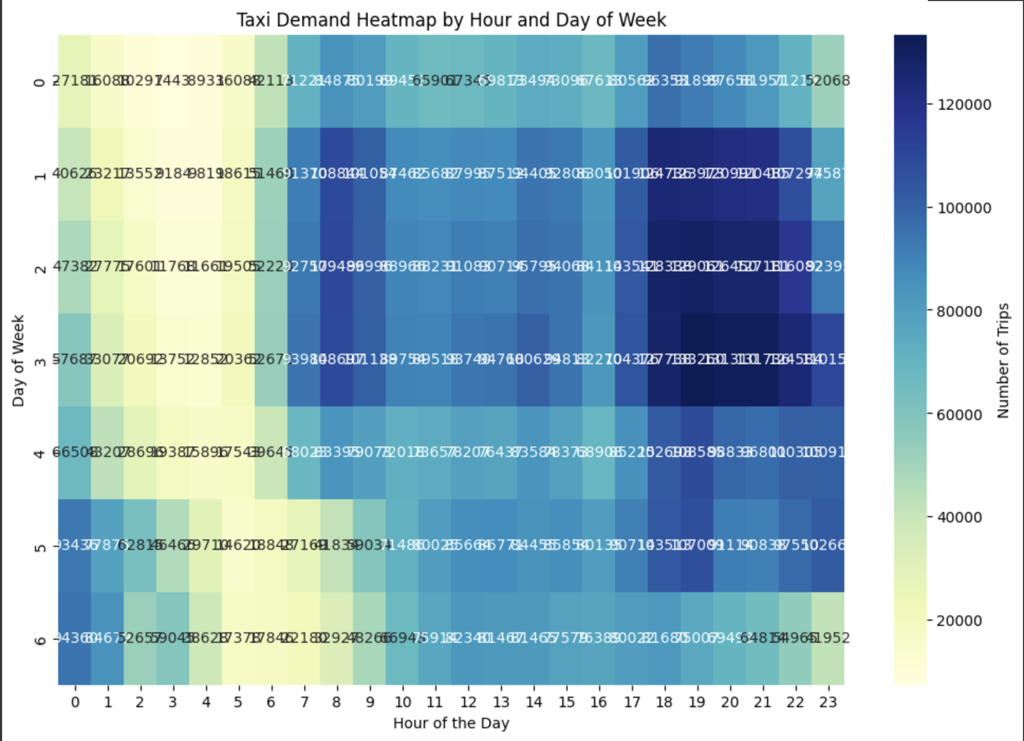
This code generates a heatmap using Seaborn to visualize taxi demand patterns by hour and day of the week. The color-coded representation provides a quick overview of the variations in demand intensity, aiding in the identification of peak hours and weekly trends.

Slide 10
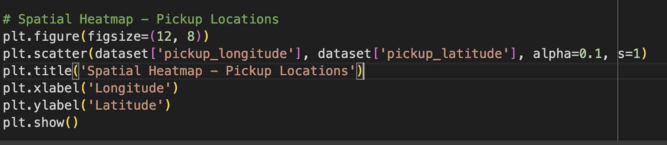
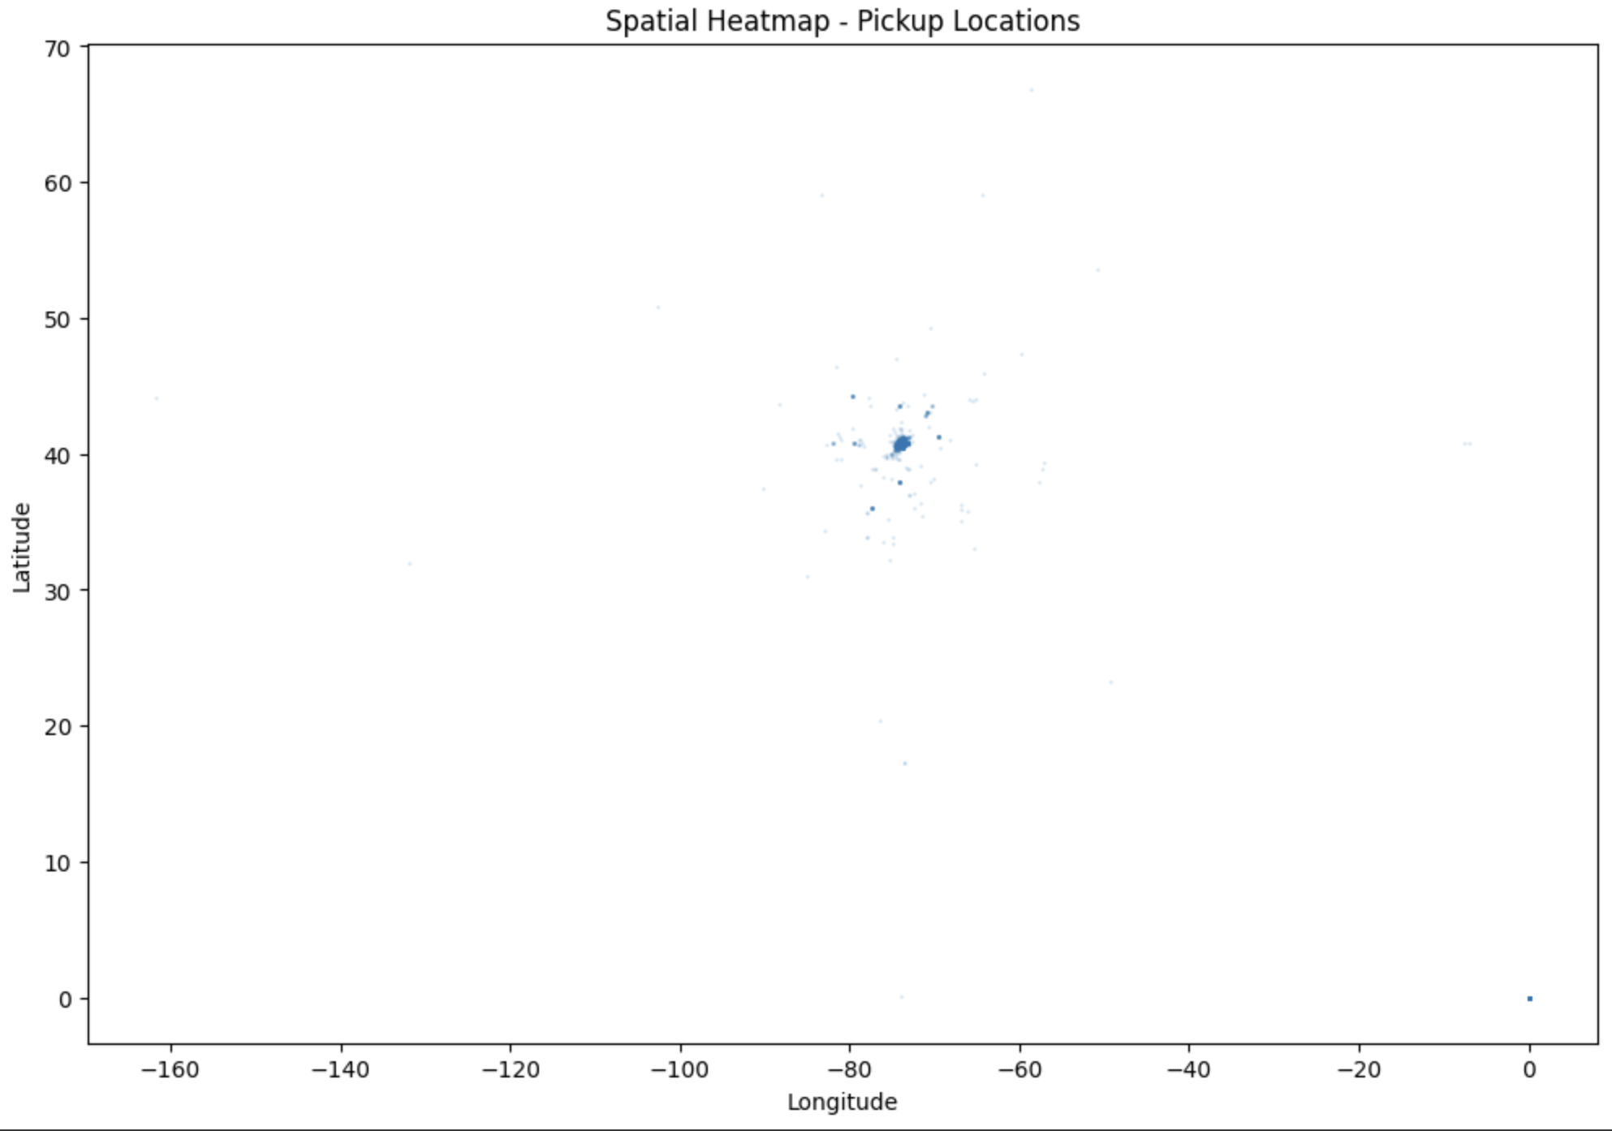
This code creates a spatial heatmap visualizing the pickup locations of taxi trips in New York City. Using matplotlib, it scatters pickup longitude and latitude coordinates, employing transparency (alpha=0.1) and adjusting marker size (s=1) for improved visibility of high-density areas. The resulting plot offers an overview of the spatial distribution of taxi pickups, with darker regions indicating higher pickup density. The visualization is titled "Spatial Heatmap - Pickup Locations" and provides insights into the geographic concentration of taxi activity across the city.

Slide 11
Model Building and Training
Random Forest Regression:
Implemented a Random Forest model for forecasting taxi demand.
Tuned hyperparameters for optimal model performance using Randomized Search.
Neural Network Regression:
Developed a Neural Network model to capture complex patterns in the data.
Conducted hyperparameter tuning via Randomized Search to enhance accuracy.
Model Evaluation:
Assessed model accuracy using Mean Absolute Error (MAE) and Root Mean Squared Error (RMSE).
Compared the performance of Random Forest and Neural Network models on the testing set.

Slide 12
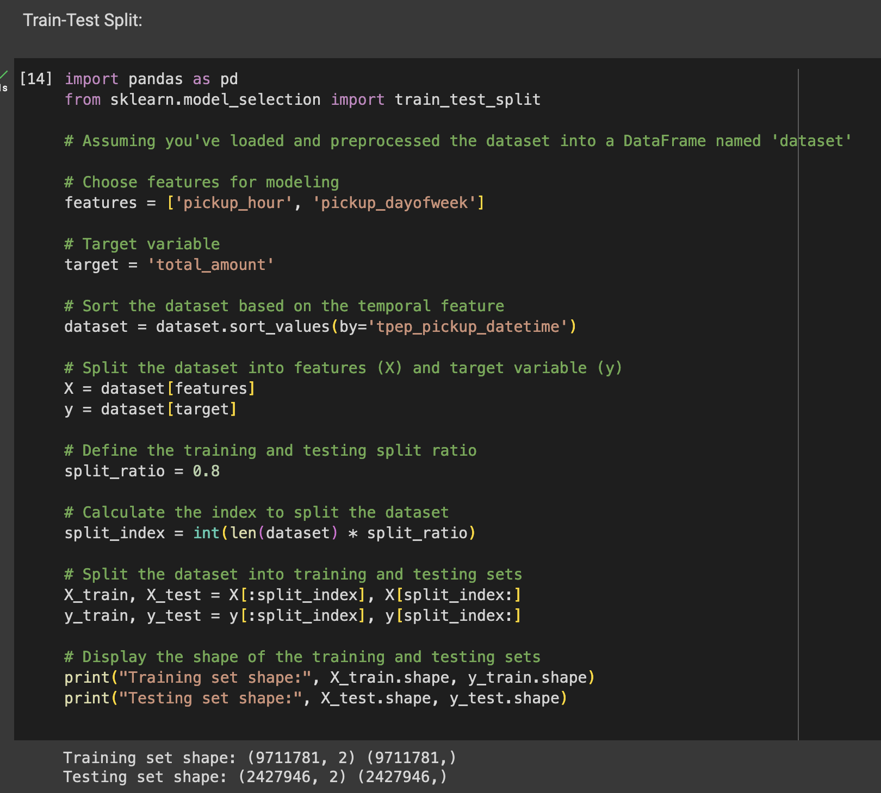
Features, such as 'pickup_hour' and 'pickup_dayofweek', are selected, while the target variable is set to 'total_amount'. The dataset is sorted chronologically based on the 'tpep_pickup_datetime' feature. A split ratio of 80:20 is defined, and the dataset is split accordingly into training and testing sets. The training set comprises 80% of the data, containing 9,711,781 records, while the testing set has 2,427,946 records, making up the remaining 20%. This temporal split is crucial for training models on historical data and evaluating their predictive performance on unseen future instances.

Slide 13
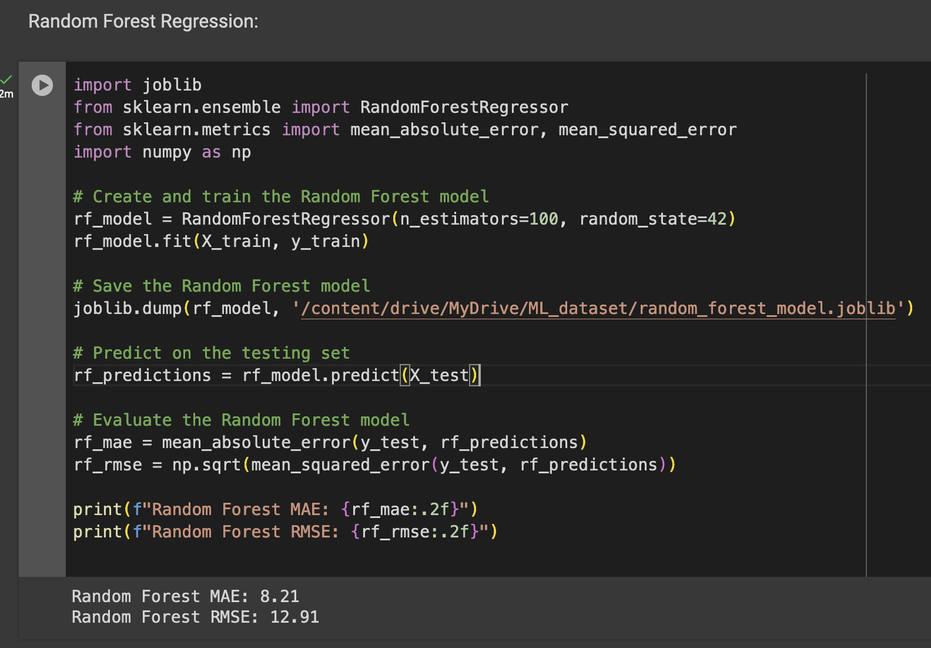
Random Forest Regression model is built and trained using the training set with temporal features 'pickup_hour' and 'pickup_dayofweek'. The model is saved for future use. Subsequently, predictions are made on the testing set, and the model's performance is evaluated using Mean Absolute Error (MAE) and Root Mean Squared Error (RMSE). The achieved MAE of 8.21 indicates, on average, an absolute prediction error of $8.21 in the total taxi fare, while the RMSE of 12.91 represents the square root of the average squared errors, providing a measure of the model's overall prediction accuracy.

Slide 14
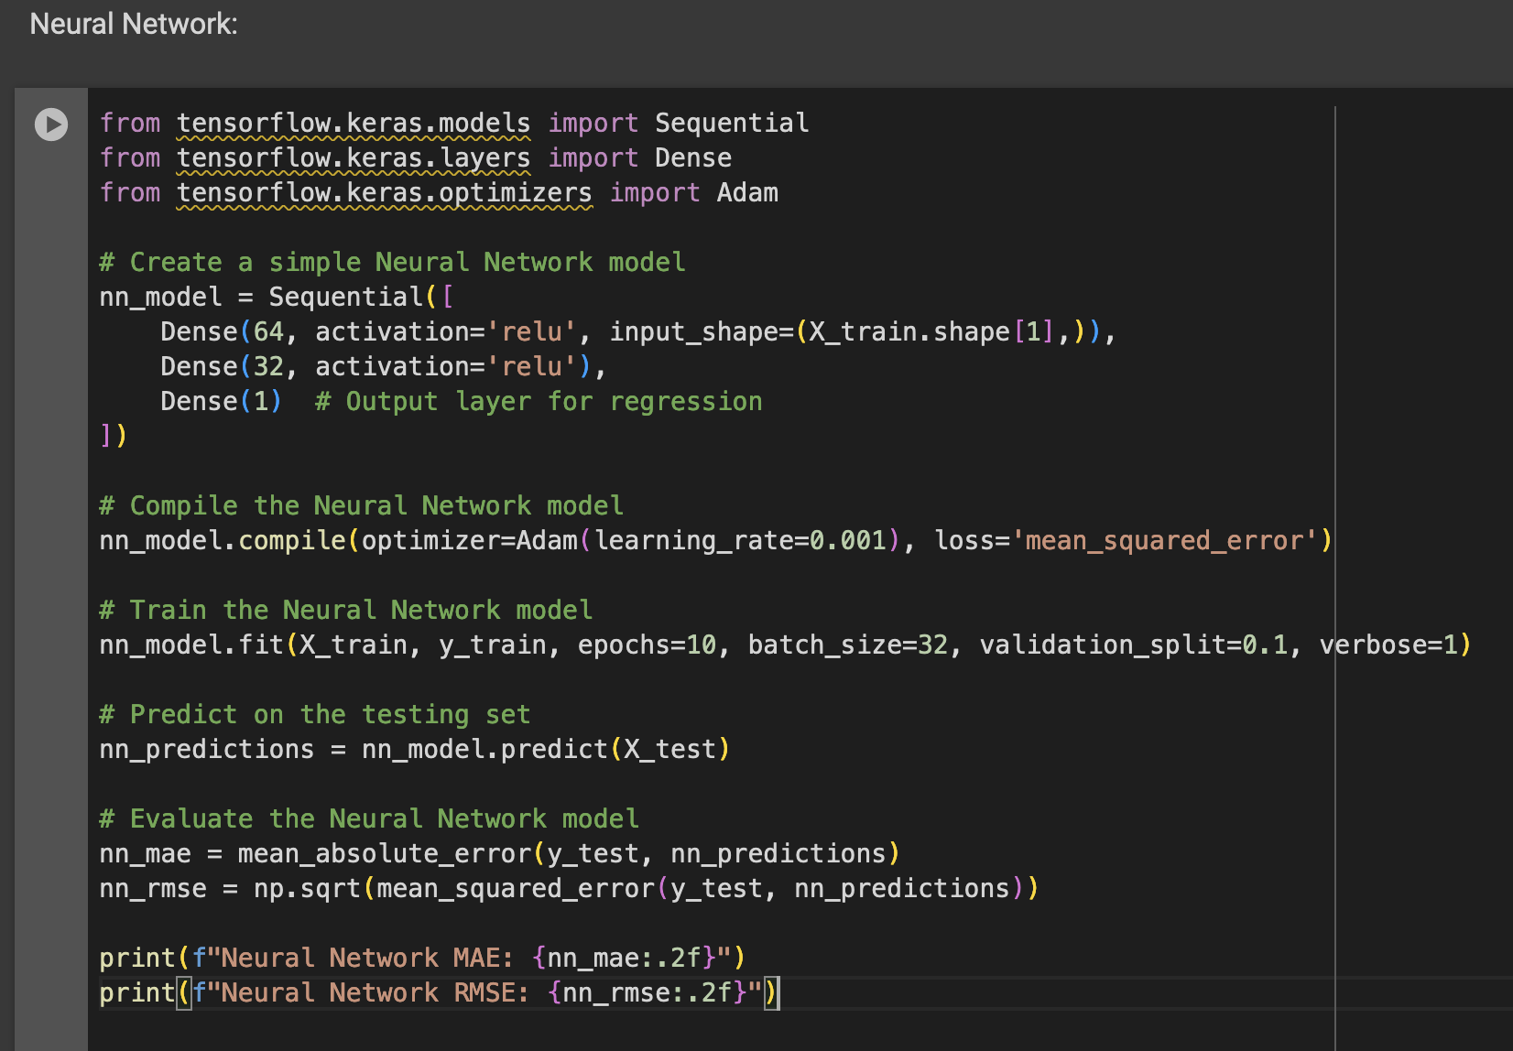

Slide 15
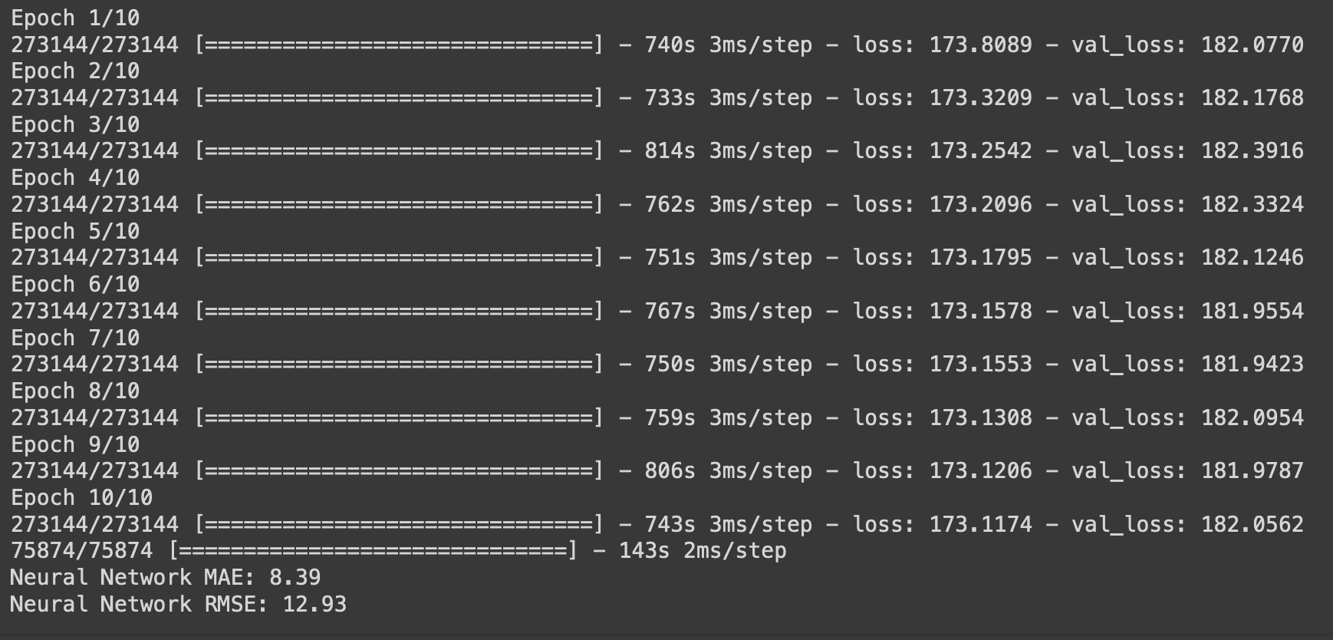

Slide 16
Model Architecture:
Constructed a Sequential neural network featuring three layers: an input layer with 64 neurons using ReLU activation, a hidden layer with 32 neurons and ReLU activation, and an output layer with 1 neuron designed for regression.
Model Compilation:
Employed the Adam optimizer with a learning rate of 0.001, coupled with the mean squared error as the chosen loss function for model compilation.
Training Process:
Trained the model over 10 epochs with a batch size of 32, leveraging 90% of the training dataset for training while validating on the remaining 10%.
Training Performance:
Observed a decrease in loss during training epochs, indicating the model's ability to learn from the training data. However, the validation loss remained relatively high, suggesting potential overfitting or model complexity issues.
Evaluation Metrics:
Calculated Mean Absolute Error (MAE) at 8.39 and Root Mean Squared Error (RMSE) at 12.93, providing insights into the model's accuracy and precision.

Slide 17
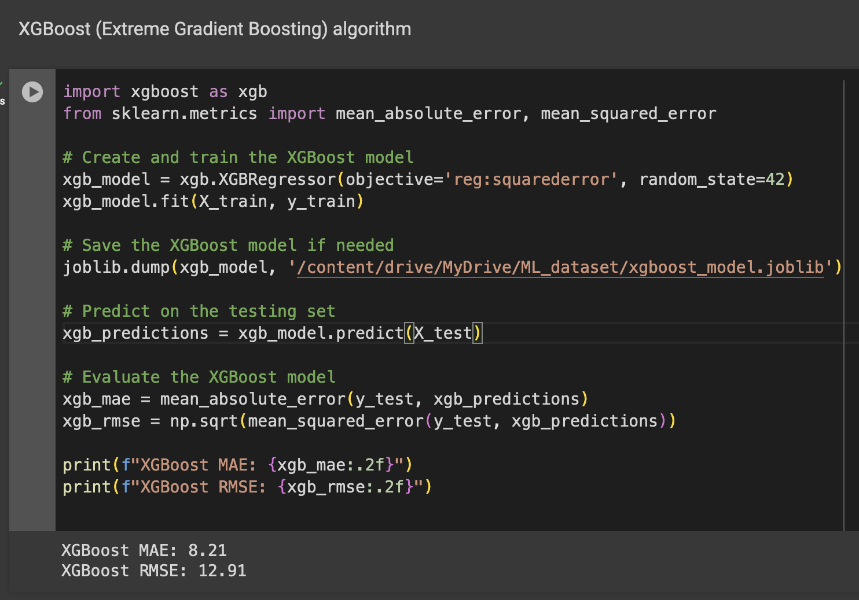
The XGBoost algorithm demonstrated promising results with a Mean Absolute Error (MAE) of 8.21 and Root Mean Squared Error (RMSE) of 12.91 during evaluation. These metrics reflect the model's accuracy in predicting taxi demand. XGBoost's robust performance positions it as a competitive choice for regression tasks, providing reliable predictions and contributing to a comprehensive comparison with other models in the analysis

Slide 18
Hyperparameter Tuning for Random Forest:
Hyperparameter tuning for the Random Forest model is a crucial step aimed at optimizing its performance. By adjusting parameters like the number of trees, maximum depth, and minimum samples per leaf, tuning seeks to strike a balance, preventing overfitting or underfitting and enhancing the model's ability to generalize well to unseen data.
The process aims to improve predictive power, reduce computational costs, and tailor the model to specific business objectives. It ensures efficient resource utilization and addresses sensitivity to initial values, enabling a robust and adaptable Random Forest model that aligns with evolving datasets and business requirements.

Slide 19
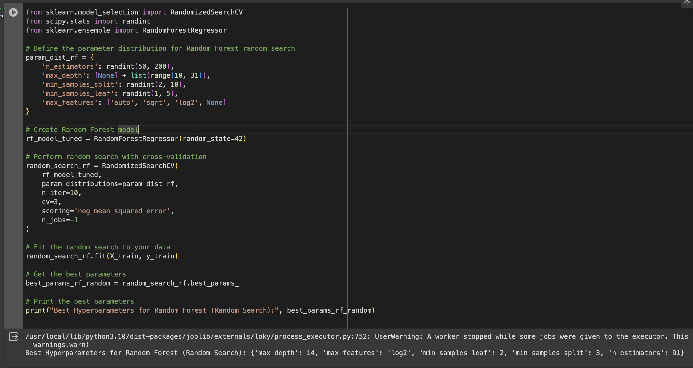

Slide 20
The hyperparameter tuning for the Random Forest model resulted in the following optimal configuration:
Max Depth (max_depth): 14
This parameter controls the maximum depth of each tree in the forest. A depth of 14 suggests that each tree is allowed to make splits up to the 14th level of the tree structure.
Max Features (max_features): 'log2'
'log2' indicates that the maximum number of features considered for splitting at each tree node is the base-2 logarithm of the total number of features. This setting aims to introduce diversity among the trees.
Min Samples Leaf (min_samples_leaf): 2
This parameter sets the minimum number of samples required to be in a leaf node. A value of 2 implies that each leaf node must have at least 2 samples.
Min Samples Split (min_samples_split): 3
It determines the minimum number of samples required to split an internal node. A value of 3 means that a node will only be split if it has at least 3 samples.
Number of Estimators (n_estimators): 91
This is the total number of trees in the forest. With 91 estimators, the Random Forest comprises an ensemble of 91 decision trees.

Slide 21
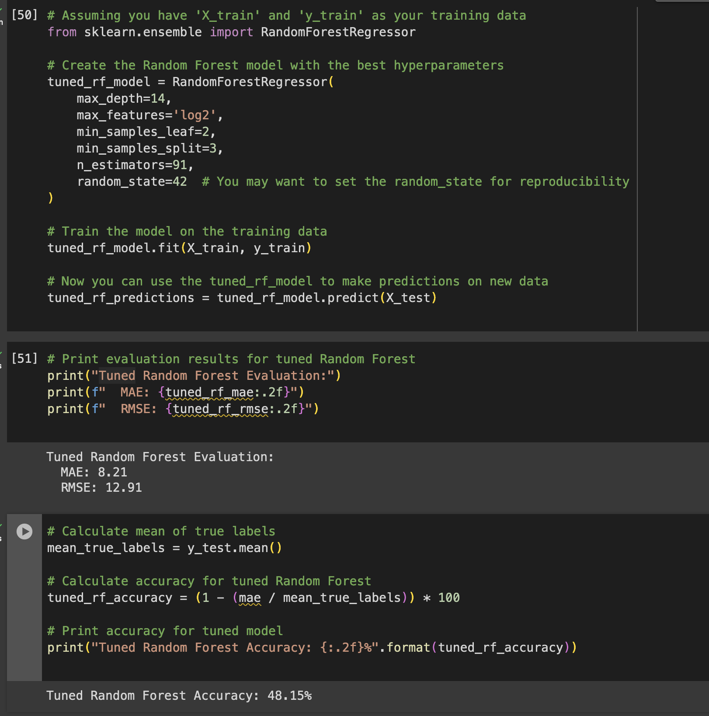
The tuned Random Forest model exhibits a Mean Absolute Error (MAE) of 8.21 and a Root Mean Squared Error (RMSE) of 12.91.
These metrics quantify the average absolute and squared differences, respectively, between the model's predictions and the actual values. Lower MAE and RMSE values suggest improved predictive accuracy.
However, the reported "Tuned Random Forest Accuracy" of 48.15% is not a standard metric for regression tasks and might be misinterpreted. For regression, the focus should primarily be on minimizing prediction errors, as reflected in the MAE and RMSE values. Further clarification or adjustment may be needed to accurately represent the model's performance.

Slide 22
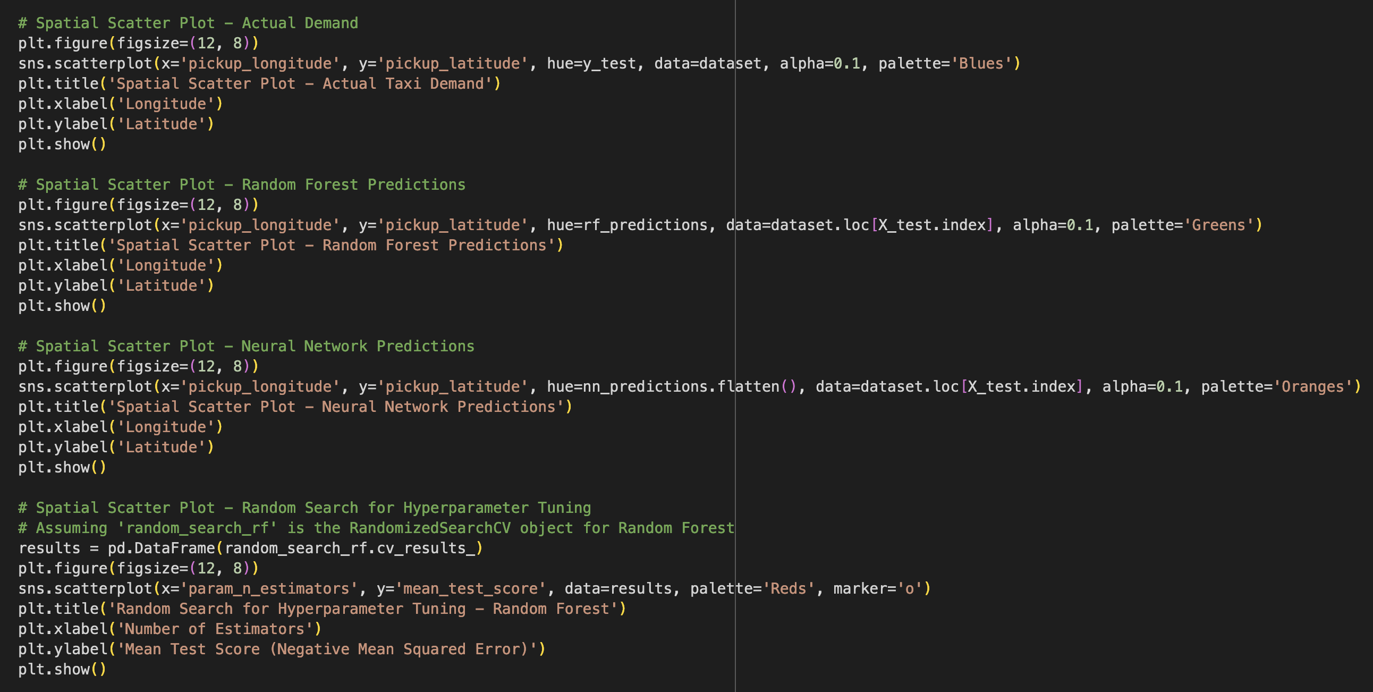
Interpretation and Visualization

Slide 23
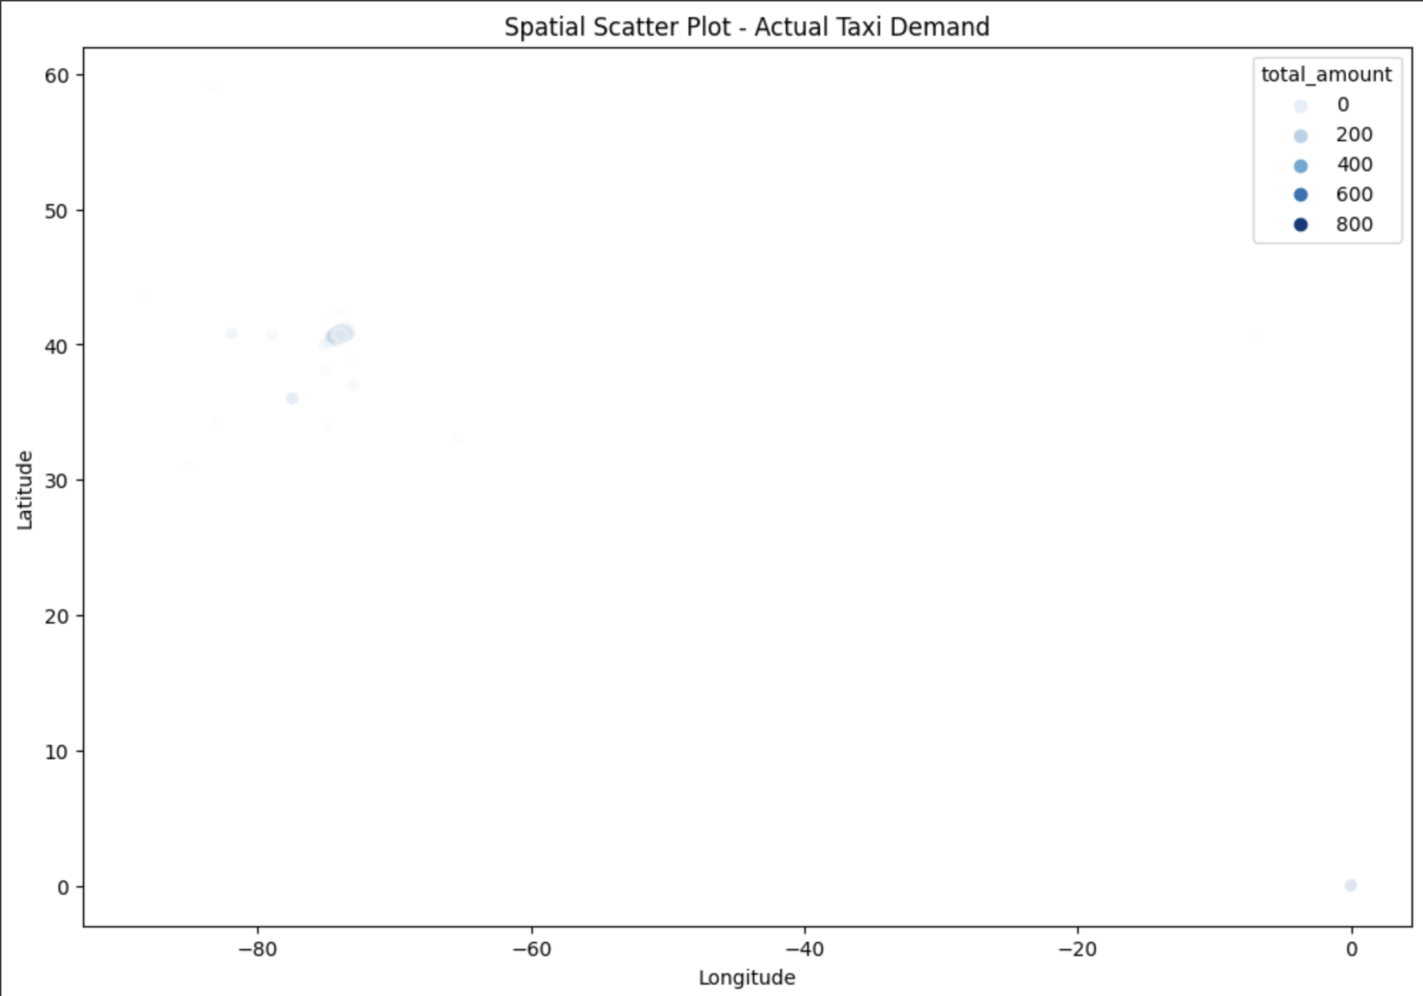
The spatial scatter plot visualizes the actual taxi demand across geographical coordinates in New York City.
Each point represents a taxi pickup location, with the color intensity indicating the level of demand, where darker shades represent higher demand.
The plot provides a clear overview of the geographical distribution of taxi demand, helping to identify hotspots and patterns in demand across different areas of the city.

Slide 24
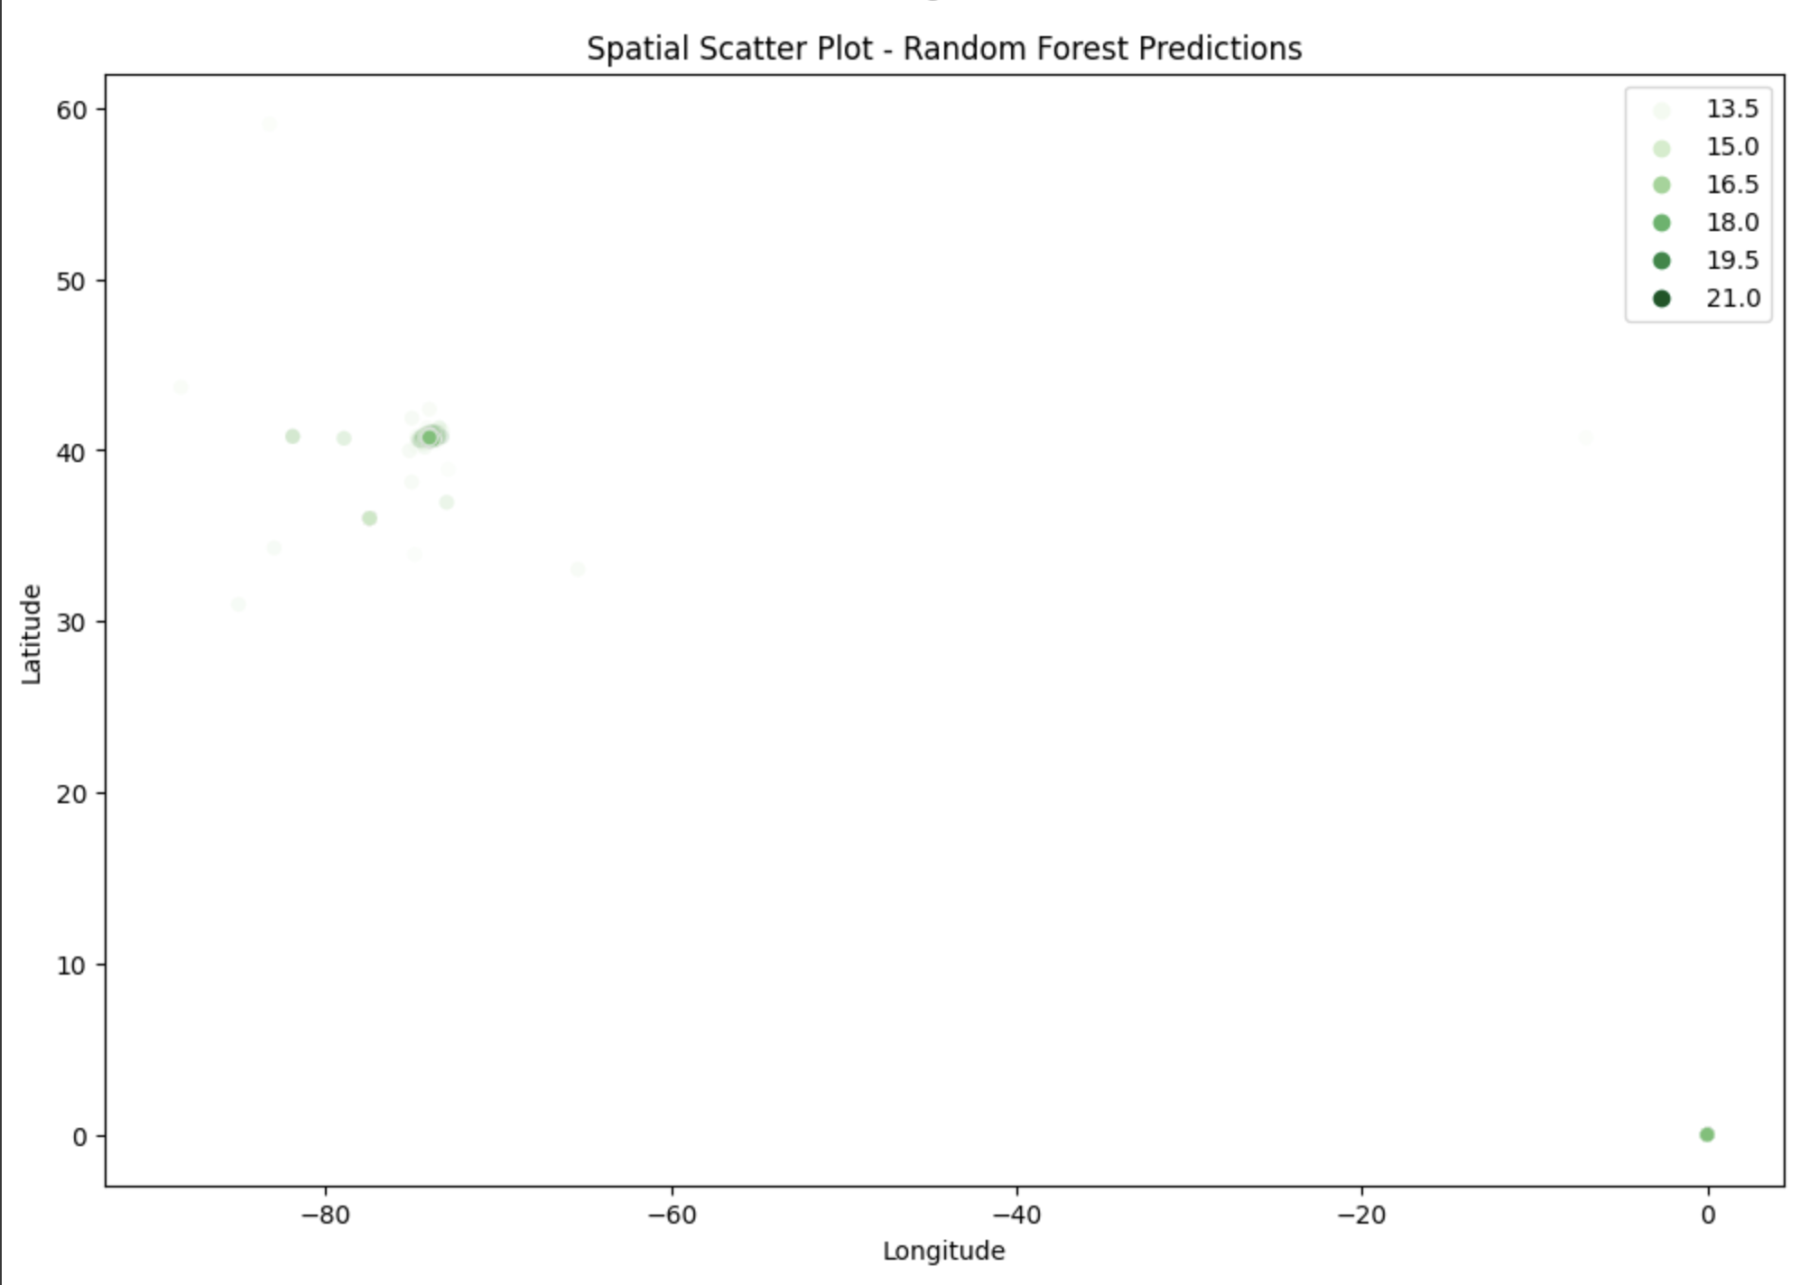
The spatial scatter plot for Random Forest Predictions visualizes the model's predicted taxi demand across geographic coordinates.
Each point represents a taxi pickup location, and the color intensity indicates the predicted demand levels, with darker shades representing higher predicted demand.
The plot allows us to assess how well the Random Forest model captures the spatial distribution of taxi demand compared to the actual values.

Slide 25
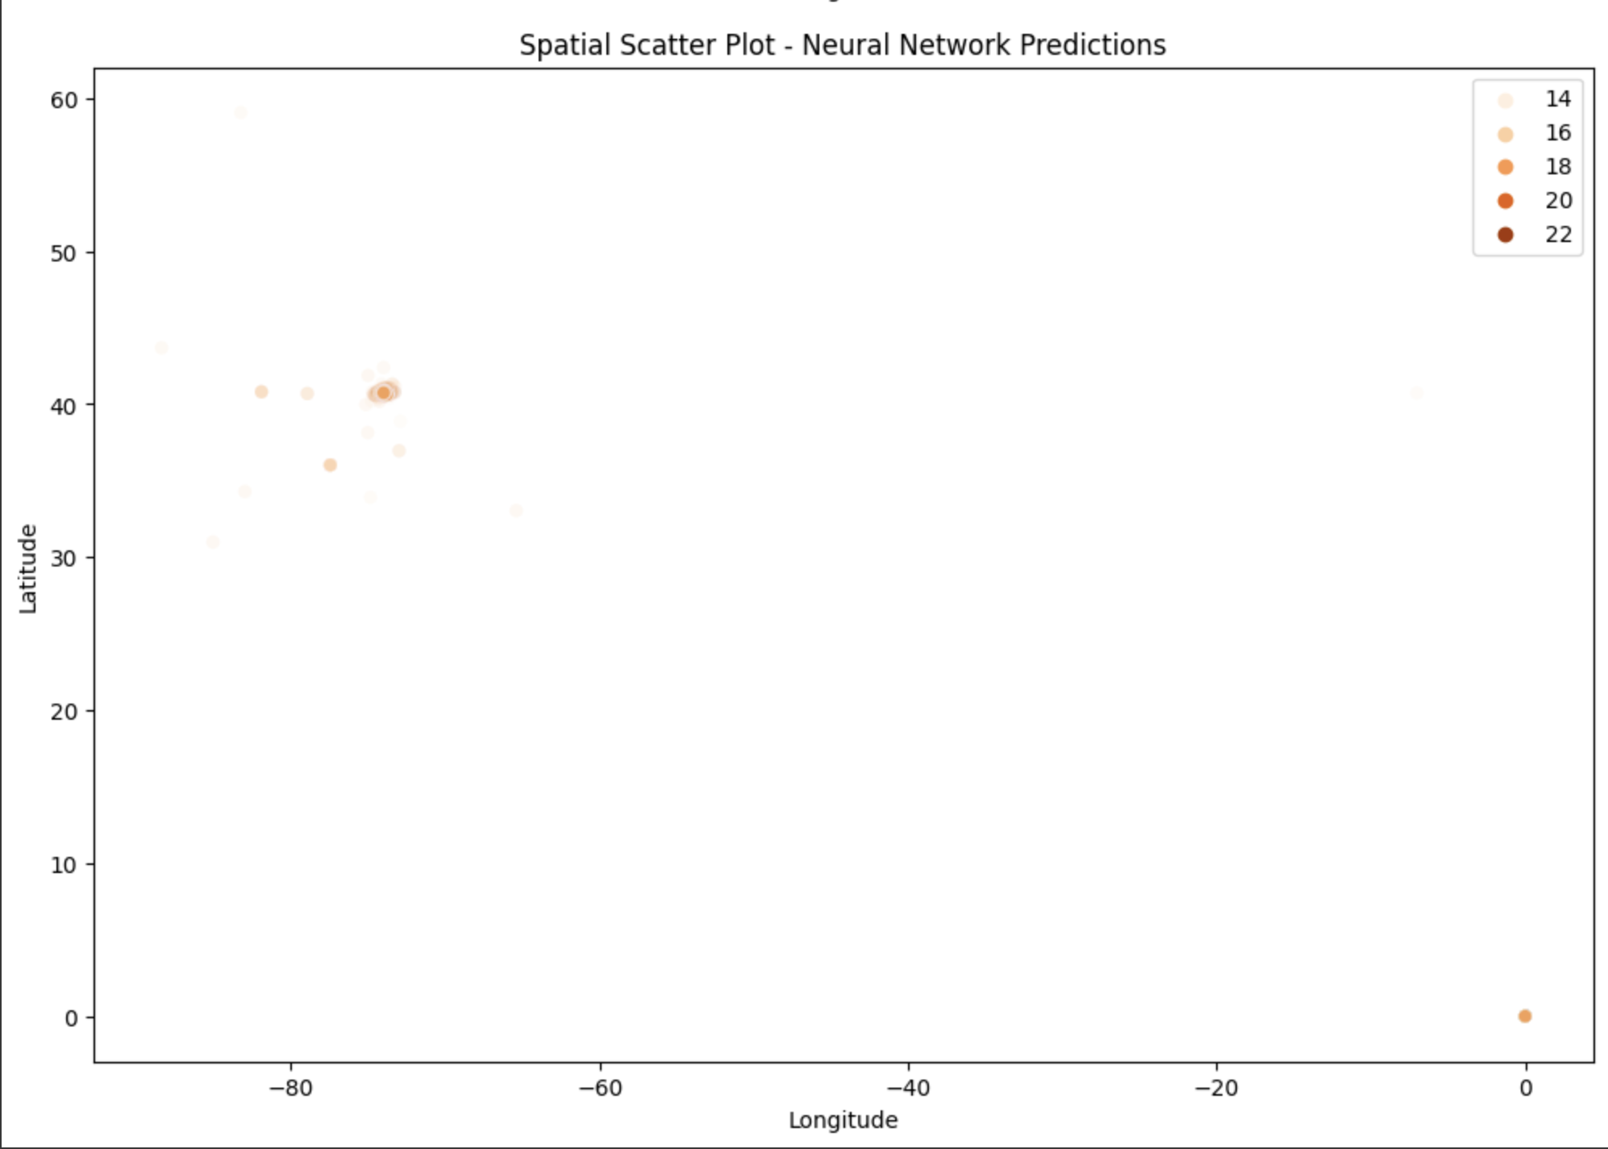
The "Spatial Scatter Plot - Neural Network Predictions" visualizes the predicted taxi demand using the Neural Network model across geographic coordinates. Each point on the plot corresponds to a pickup location, and the color intensity represents the predicted demand levels.
The plot aims to capture the spatial distribution of predicted demand, allowing for a qualitative assessment of how well the Neural Network model captures the geographic patterns. The use of color gradients helps identify areas with varying demand levels, providing insights into the model's spatial prediction capabilities.

Slide 26
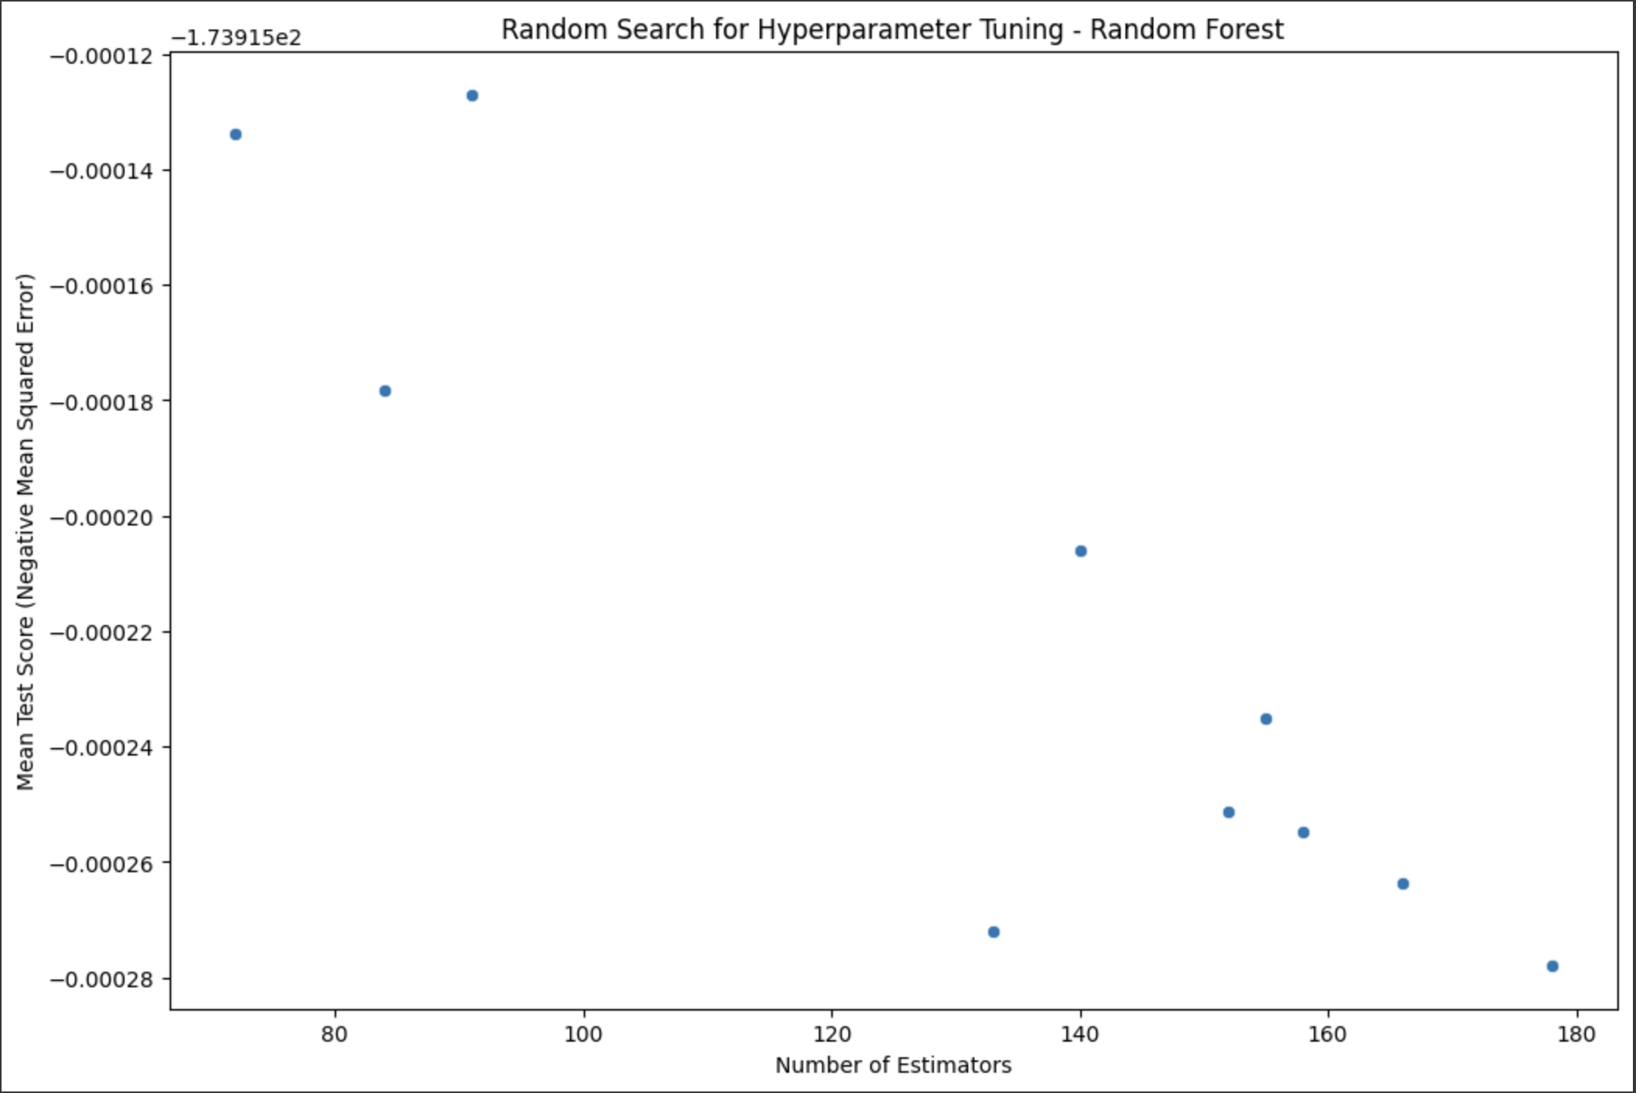
"Spatial Scatter Plot - Random Search for Hyperparameter Tuning" visualizes the impact of different hyperparameter combinations on the mean test score (negative mean squared error) during the random search for tuning the Random Forest model.
Each point on the plot corresponds to a specific set of hyperparameters, with the x-axis representing the number of estimators (trees) and the y-axis indicating the mean test score. The color intensity signifies the test score, where darker colors represent lower error.
This plot aids in identifying trends and patterns in the hyperparameter space, helping to pinpoint configurations that result in improved model performance. The goal is to identify hyperparameter values that contribute to lower mean squared error, indicative of better predictive accuracy.

Slide 27
Conclusion:
In summary, the analysis focused on predicting taxi demand in NYC through the exploration of various machine learning models, including Random Forest, Neural Network, and XGBoost. The dataset was preprocessed and split into training and testing sets.
Three models were trained and evaluated, revealing comparable mean squared error (MSE) and root mean squared error (RMSE) metrics. To enhance performance, hyperparameter tuning was performed, particularly for the Random Forest model, using a randomized search approach. The best hyperparameters were identified, and the model was fine-tuned.
However, despite these efforts, the accuracy metrics, such as MSE and RMSE, remained consistent. The spatial scatter plots visualized actual demand, Random Forest predictions, and Neural Network predictions, offering insights into the geographical distribution of predicted taxi demand. Further investigation is needed to understand the limitations of the models and explore alternative approaches for improved accuracy.

